Slide 1


STOCK VISUALIZATION AND FORECASTING
Team Members:
V S S VEERENDRA KUMAR
D S KARTHIKEYA MADHAVAN
D ISSAC
Mentor:
Mr. DASARI PRASAD

Slide 2
ABSTRACT
This study delves into the crucial realm of stock visualization and forecasting, recognizing its paramount significance in contemporary financial landscapes. With the escalating complexity of global markets and the abundance of data available, the need for robust analytical tools has become more pressing than ever. Through the introduction of a pioneering annotated dataset and the utilization of a Long Short-Term Memory (LSTM) network model combined with Min-Max normalization, this research endeavors to push the boundaries of stock market analysis.
In the current era, characterized by rapid technological advancements and the ubiquity of information, stock visualization and forecasting serve as indispensable pillars for informed decision-making in investment strategies. By harnessing the power of advanced machine learning techniques, this study endeavours to empower investors and analysts with accurate predictions and actionable insights. Moreover, the development of a user-friendly web interface further democratizes access to predicted data, bridging the gap between complex analytical methodologies and practical application.
The fusion of sophisticated predictive modeling with intuitive visualization tools not only augments the efficiency of stock market analysis but also facilitates more informed decision-making processes. In an environment where timeliness and accuracy are paramount, the proposed approach holds the potential to revolutionize how stakeholders navigate the intricacies of financial markets. Ultimately, by offering valuable insights and actionable predictions, this research aims to empower individuals and organizations to navigate the volatile terrain of the stock market with confidence and agility.

Slide 3
PROBLEM STATEMENT
Develop a web application aimed at visualizing and forecasting stock market data to assist investors in making informed decisions. In the ever-changing realm of stock markets, investors grapple with the daunting task of sifting through copious historical data, spotting trends, and making accurate predictions about future stock prices. Existing tools often lack the sophistication and user-friendliness required for such analysis, leaving investors without adequate support.

Slide 4
LITERATURE REVIEW
Quantitative finance has witnessed a paradigm shift with the advent of machine learning algorithms, which offer sophisticated methods for forecasting asset prices, managing portfolios, and optimizing investment strategies. Traditional linear models have been supplemented by complex algorithms like neural networks, gradient boosted regression trees, and support vector machines, enabling the detection of non-linear patterns and intricate relationships in financial data.
MOGHARa and HAMICHEb's study leverages LSTM, a specialized form of RNN capable of retaining long-term dependencies in sequential data, making it particularly suitable for time series forecasting. The authors utilize a dataset comprising daily opening prices of two stocks, GOOGL and NKE, extracted from Yahoo Finance. They partition the data into training and testing sets, employing mean squared error as the optimization metric during model training. Experiments are conducted with varying numbers of epochs to assess the impact on predictive performance.
The findings reveal that the choice of epochs significantly influences the model's ability to accurately forecast stock prices. Training with fewer data points but more epochs demonstrate improvements in forecasting accuracy. However, challenges arise from shifts in data nature, such as increased volatility or changes in asset behaviour, which may impact the model's performance. Despite these challenges, the LSTM-based approach shows promise in tracking the evolution of opening prices for both GOOGL and NKE assets.
In conclusion, MOGHARa and HAMICHEb's research underscores the potential of LSTM-based models in enhancing stock market predictions. The study contributes to the growing body of literature on the application of machine learning in quantitative finance, highlighting the importance of optimizing dataset selection and training epochs to maximize prediction accuracy. Future endeavours aim to refine model parameters and explore additional factors to further improve forecasting performance and adaptability to
dynamic market conditions.

Slide 5
Basic Stock Terms
Date: This column represents the date of the trading session. Each row corresponds to a specific date on which trading occurred.
Open: This column indicates the opening price of the stock for the trading session. The opening price is the first price at which the stock was traded when the market opened on that particular date.
High: This column represents the highest price at which the stock traded during the trading session on the given date. It reflects the peak price reached by the stock during the day.
Low: This column indicates the lowest price at which the stock traded during the trading session on the given date. It reflects the lowest price reached by the stock during the day.
Close: This column represents the closing price of the stock for the trading session. The closing price is the last price at which the stock was traded when the market closed on that particular date.
Adj Close: This column represents the adjusted closing price of the stock for the trading session. It provides a more accurate reflection of the stock's value over time.
Volume: Volume represents the total number of shares that were bought and sold during the day's trading activity.

Slide 6
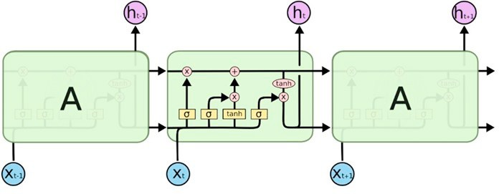
LSTM
Long Short-Term Memory (LSTM) is a type of recurrent neural network (RNN) architecture designed to address the vanishing gradient problem in traditional RNNs and effectively capture long-term dependencies in sequential data. Unlike standard RNNs, LSTM networks incorporate specialized memory cells with self-connected units known as gates, which regulate the flow of information within the network. These gates, including the input gate, forget gate, and output gate, are equipped with activation functions that control the information flow by selectively updating the memory cell state. This architecture enables LSTM networks to retain information over long sequences, making them particularly well-suited for tasks involving time-series data, natural language processing, and sequential pattern recognition. By learning which information to remember, forget, and update, LSTM networks excel at modeling complex temporal relationships and have become a cornerstone in various applications requiring the processing of sequential data.
Figure 1. The internal structure of an LSTM

Slide 7
Libraries
Flask
requests
pandas
numpy
MinMaxScaler
tensorflow
keras
yfinance
datetime
plotly

Slide 8
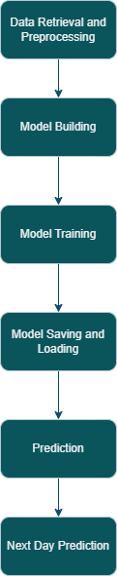
Work Flow
Figure 4.1: Steps for training the model

Slide 9
Algorithm
Import necessary libraries including pandas, numpy, scikit-learn, TensorFlow, Keras, yfinance, datetime, and matplotlib.
Define functions to build an LSTM neural network model using Keras.
Train the model using training data scaled with MinMaxScaler and sequences for input features and target values.
Test the trained model using test data obtained from Yahoo Finance and evaluate its accuracy.
Download historical stock price data from Yahoo Finance for a specified company (e.g., AAPL) and time range.
Scale the data, prepare training sequences, build LSTM models, train them, and save them to disk for different attributes.
Evaluate model accuracy for each attribute using test data and print the results.
Plot actual vs. predicted prices for visualization.
Use the trained model to predict the next day's stock price by scaling the real data, reshaping it to match the model input shape, predicting the next day's price, and inverse transforming the prediction to get the actual price.

Slide 10
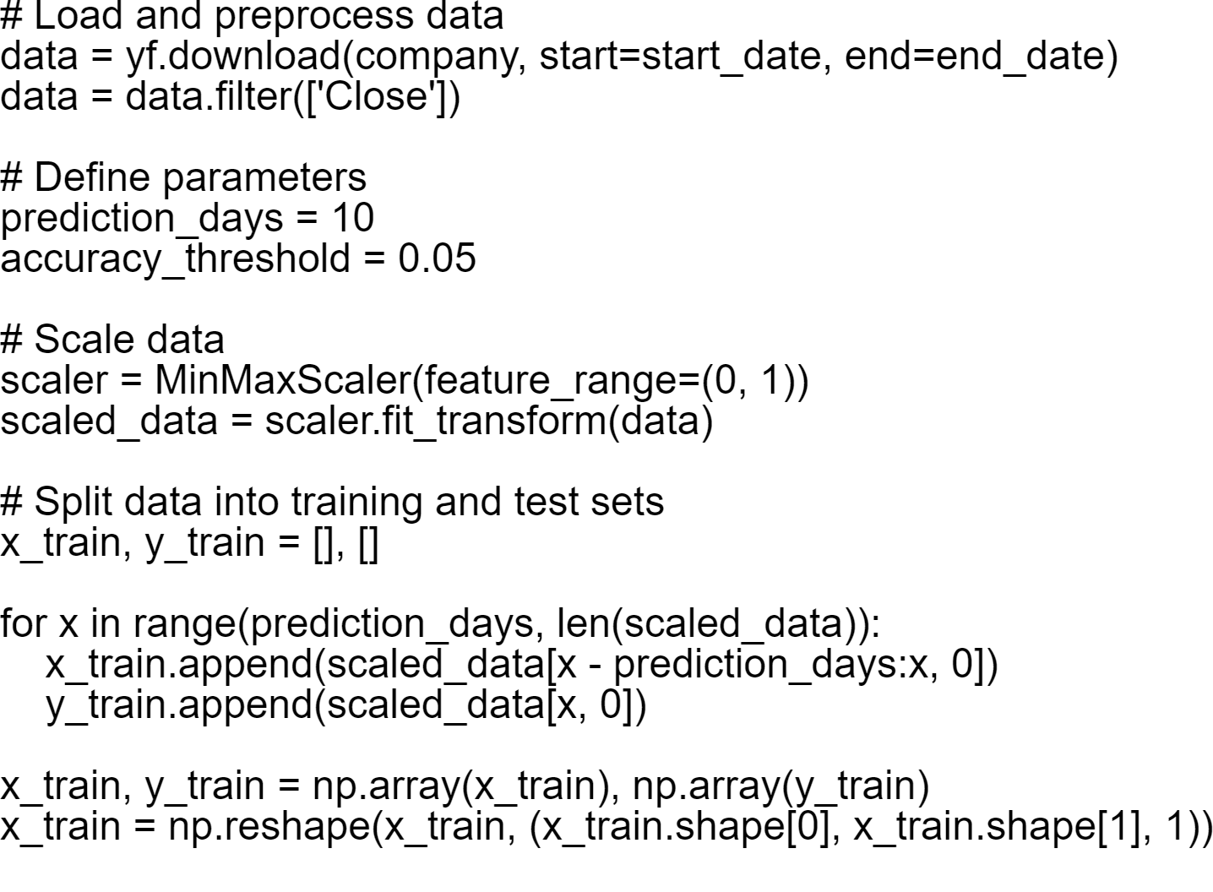
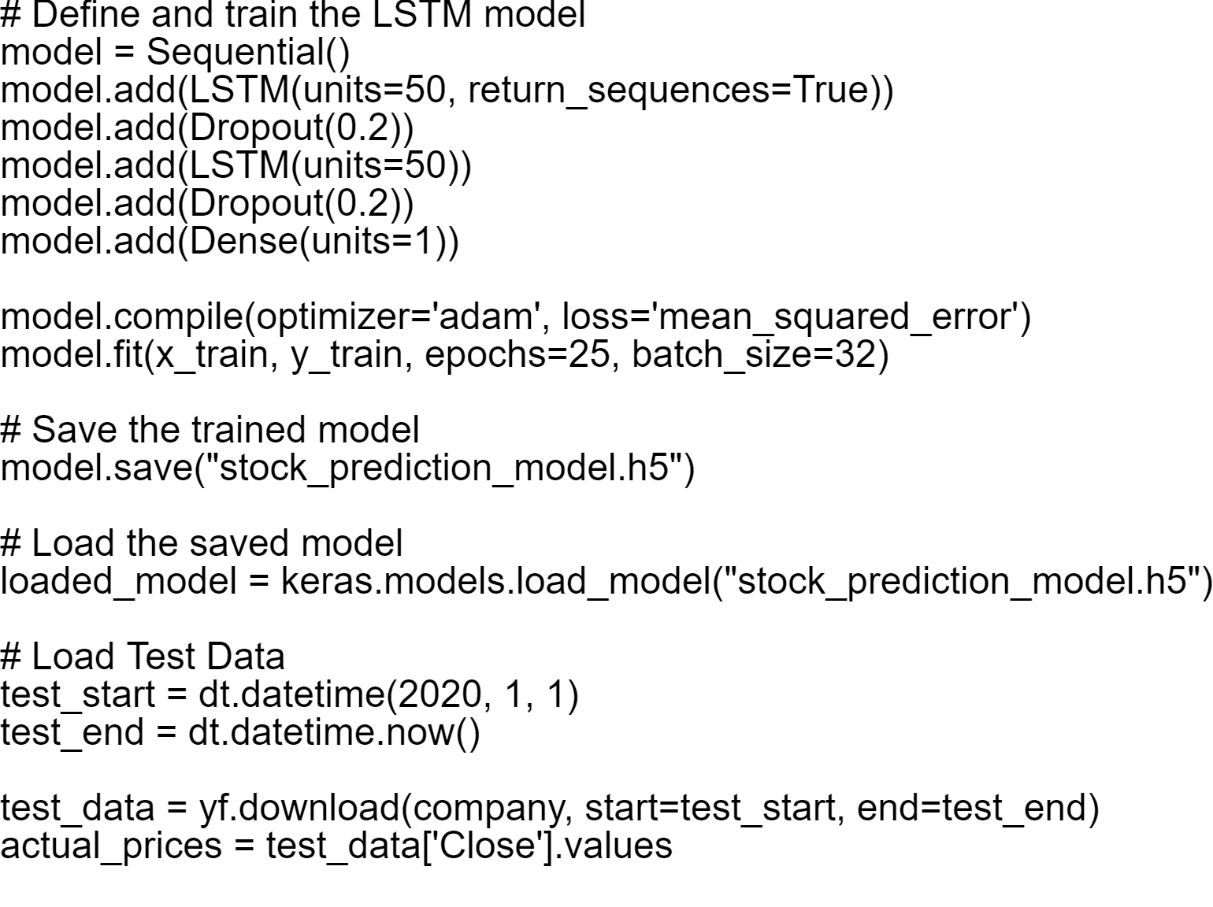

Slide 11
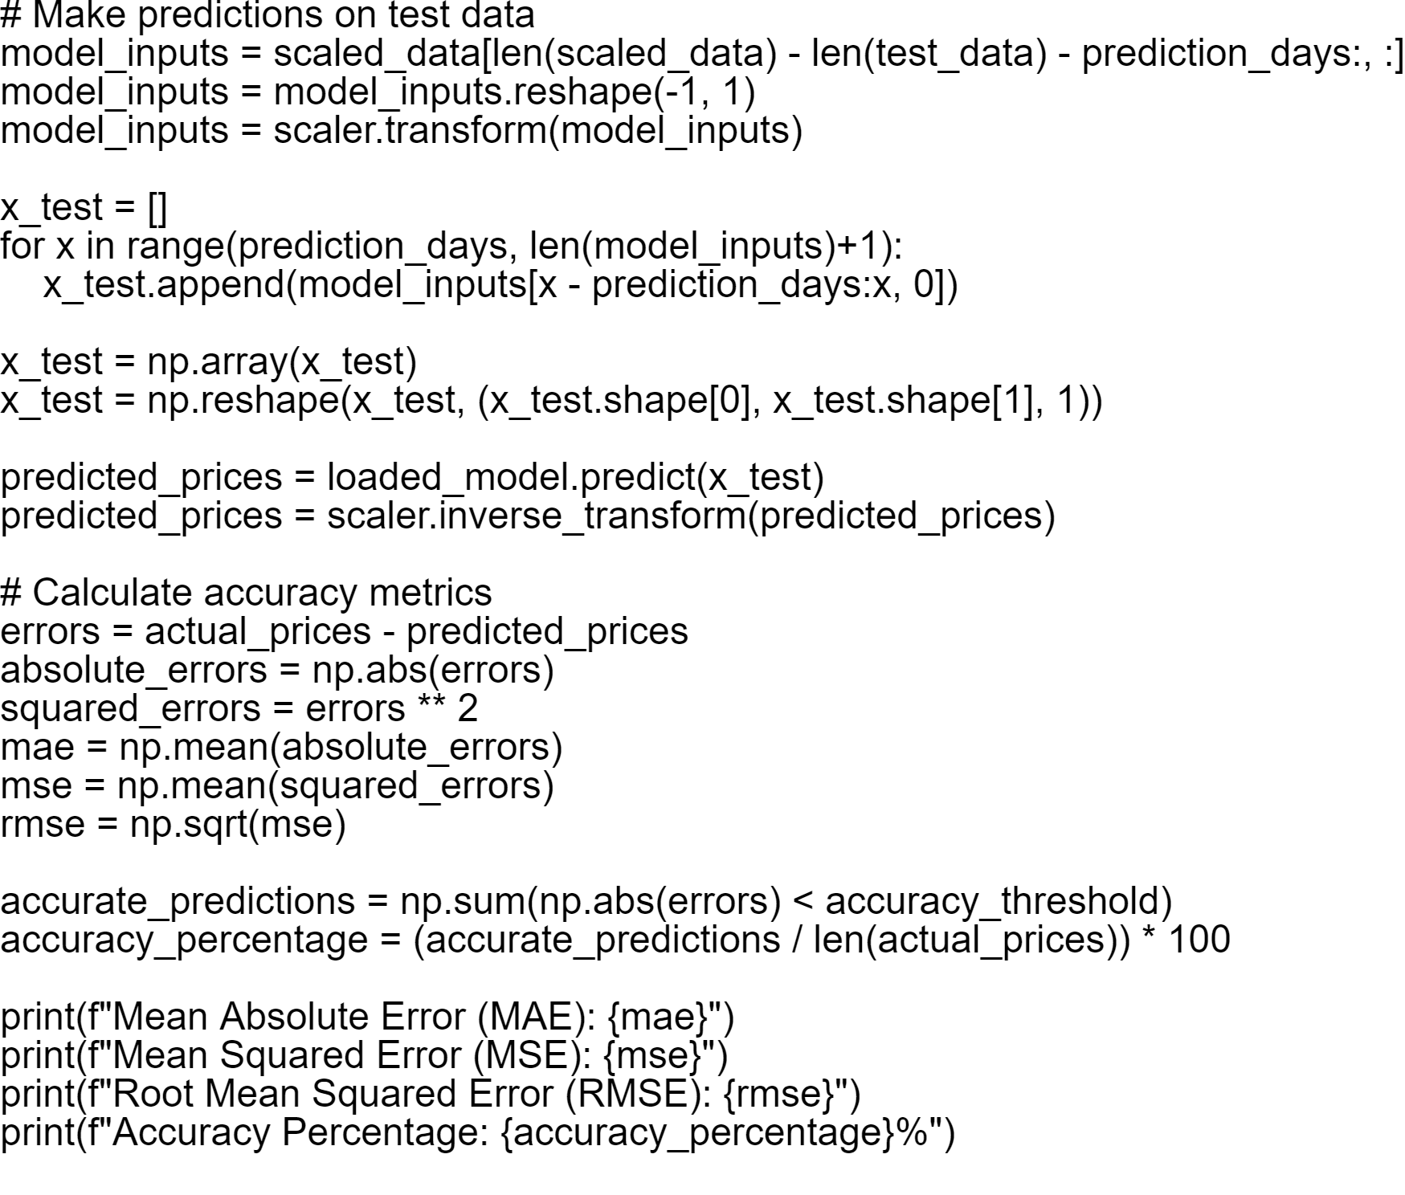

Slide 12
Dataset
Data Retrieval:
Historical stock price data for the specified company (e.g., Apple Inc., denoted as 'AAPL') is obtained from Yahoo Finance using the yf.download() function within a specified date range.
Data Preprocessing:
The 'Close' price data from the downloaded dataset is extracted for further processing.
MinMax normalization is applied to scale the 'Close’, ‘Open’, ‘High’, ‘Low’ prices to a range between 0 and 1 using the MinMaxScaler from sklearn.preprocessing.

Slide 13
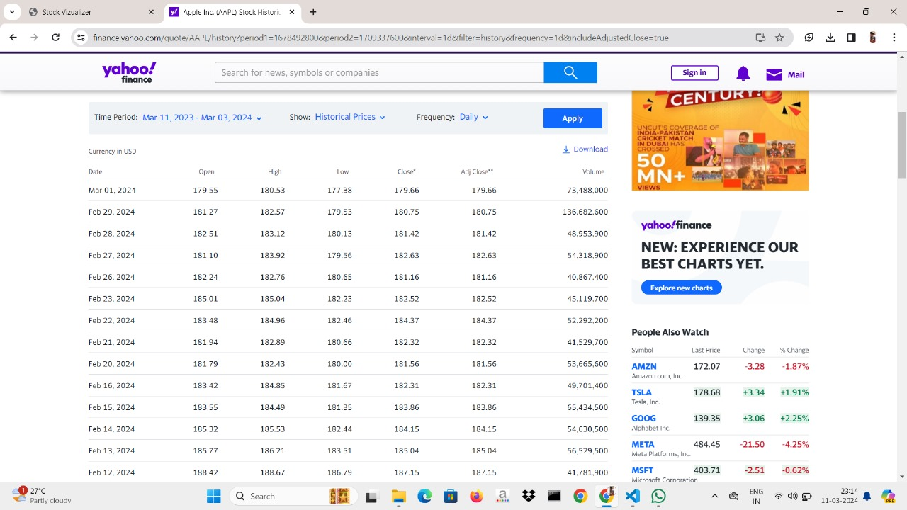
This is the section where we retrieve the dataset from Yahoo Finance. The image displayed here represents the dataset utilized for the prediction process.
Date

Slide 14
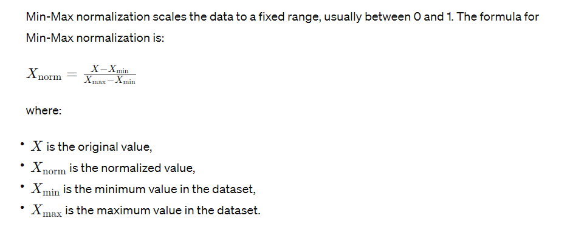
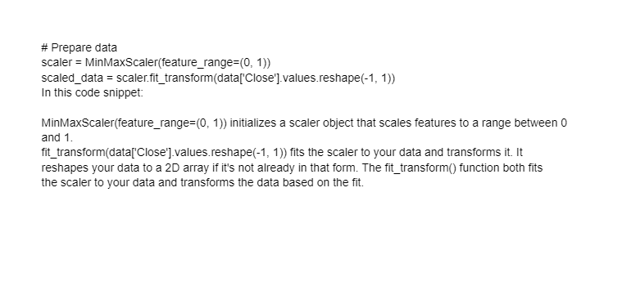
Data Normalization

Slide 15
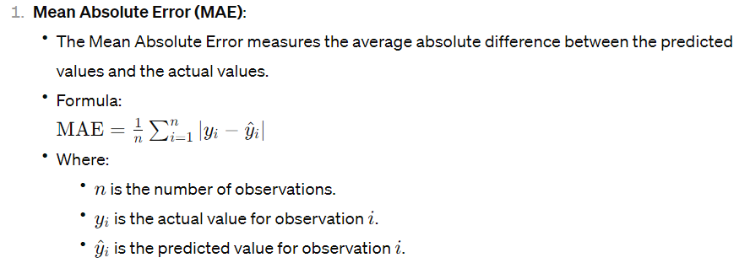
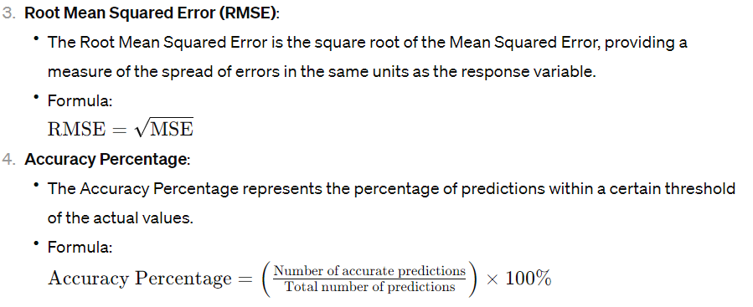
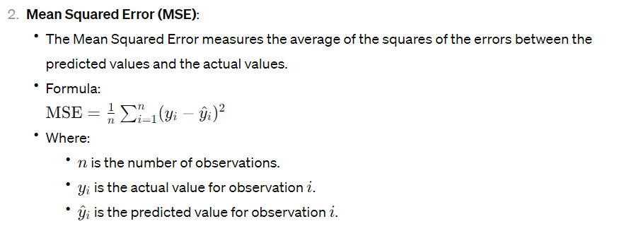
Accuracy Calculation

Slide 16
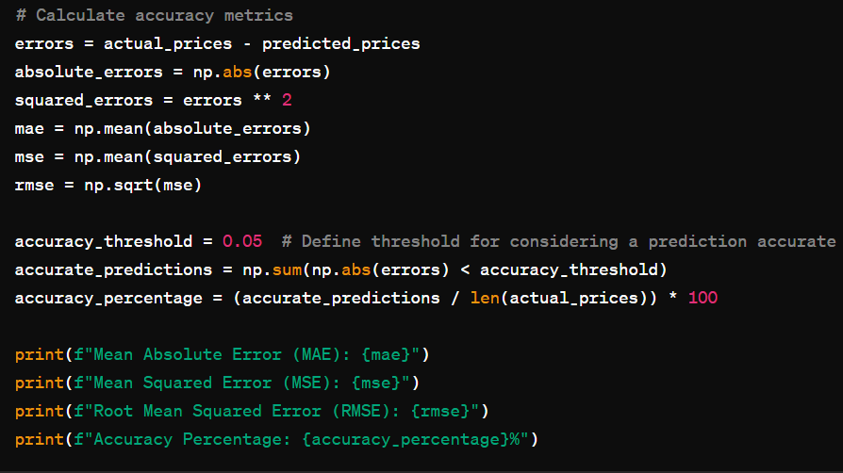
Accuracy Calculation

Slide 17
Technologies
HTML (Hypertext Markup Language):
Provides the structure and content of webpages.
Defines the elements and layout of the webpage.
CSS (Cascading Style Sheets):
Styles the HTML elements, controlling their appearance and layout.
Defines the visual presentation of the webpage, including colors, fonts, and spacing.
JavaScript:
Adds interactivity and dynamic behavior to the webpage(Notifications).
Enables client-side scripting, allowing for features like form validation, animations, and DOM manipulation.
Flask:
Flask is a lightweight web framework in Python used for building web applications.
It facilitates tasks like routing, rendering templates, handling requests, and interacting with databases.

Slide 18
Web Interface
Welcome page:
A visually appealing welcome page for a website. It features a full-screen video background that plays automatically and loops continuously. The content, including a welcoming message and an "Enter" button, is centered on the page. The text color of the heading undergoes a subtle animation, transitioning between white and a lighter shade. When the "Enter" button is clicked, it triggers a JavaScript function that redirects the user to another page, likely the main page of the website, using Flask's url_for function. The combination of video background, animation, and interactive button provides an engaging introduction to the website, inviting users to explore further.
Home page:
A webpage for a stock visualization platform. It includes a navigation bar with links to different sections like Products, Community, Markets, News, Brokers, and More, each with nested dropdown menus for more specific options. The page also features sections for text content, including a headline promoting the platform's charting capabilities and a video section displaying market-related content. It incorporates Tailwind CSS for styling, Font Awesome for icons, and JavaScript for interaction, such as toggling the dropdown menus and redirecting users upon button click. Additionally, it utilizes Flask's url_for function to dynamically generate URLs for static assets and page redirects, enhancing the scalability and maintainability of the web application.
Prediction page:
A webpage for stock prediction functionality. It includes a form allowing users to select a company, attribute, and graph type for stock visualization. Upon submission, the form sends a POST request to "/home1" for processing. The page also displays information about the selected company, including a predicted value with an arrow indicator based on today's value, if available. Additionally, it features a container for displaying the stock graph, which is dynamically updated based on user input. The script section utilizes JavaScript to handle page load events, store and retrieve input values and graph data from session storage, and dynamically update the form inputs and graph display accordingly.

Slide 19
Web Interface
News page:
This HTML code template is designed for presenting news articles on a web page. It includes CSS styling for layout and visual presentation. The page structure consists of a title, "Latest News," and an unordered list (<ul>) where each article is displayed. Each article includes a link (<a>) to read more about it. The CSS styles define the layout, colors, and fonts for the elements. The code assumes dynamic content in the form of a list of articles, indicating its integration with server-side technologies for data rendering.
Profit Calculator page:
This HTML code template is for a form that calculates profit based on user input. It's structured with HTML elements and styled using CSS for visual presentation. The form includes input fields for selecting a company, entering the number of shares, and specifying buying and selling dates. Upon submission, the form sends data to a server-side endpoint for profit calculation. The CSS styles define the layout, colors, and fonts for the elements. The calculated profit is displayed below the form in a designated <div> with the id "profit".

Slide 20
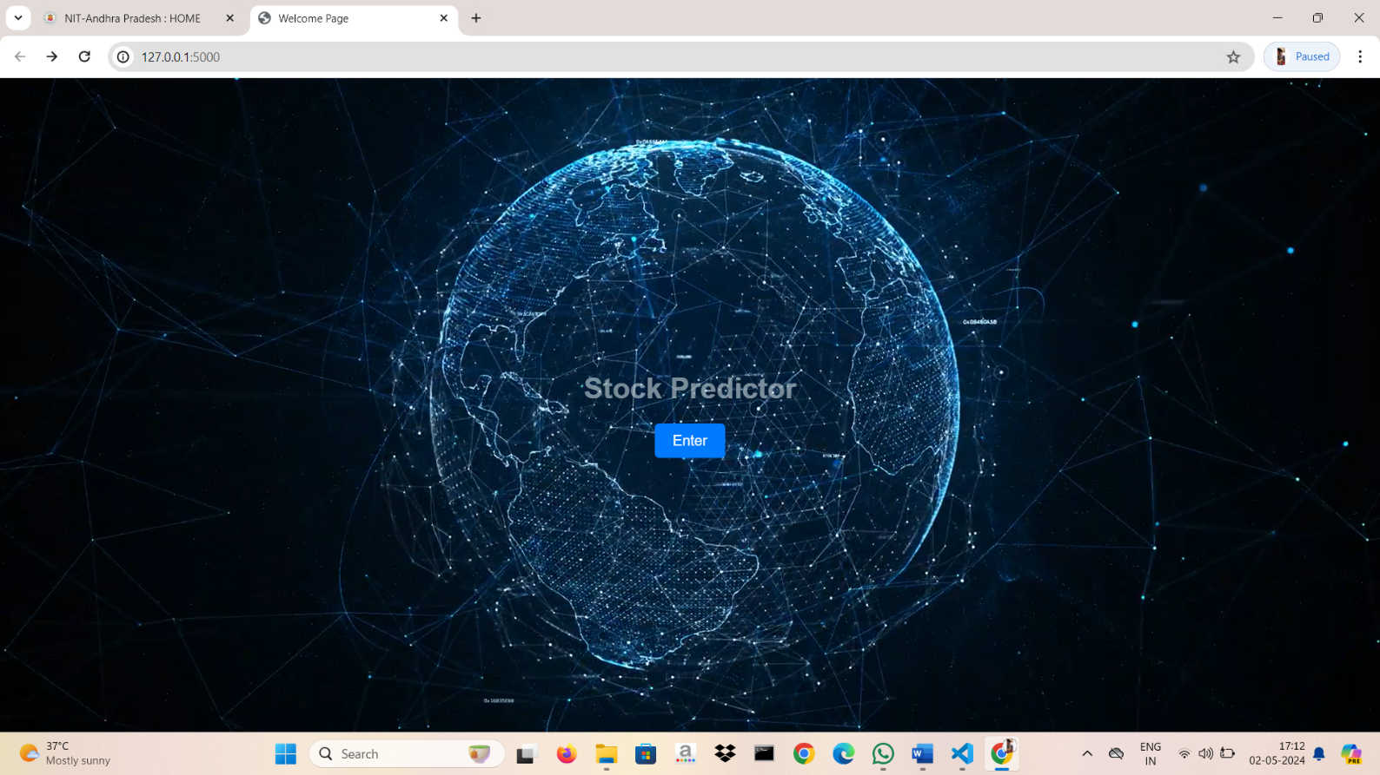

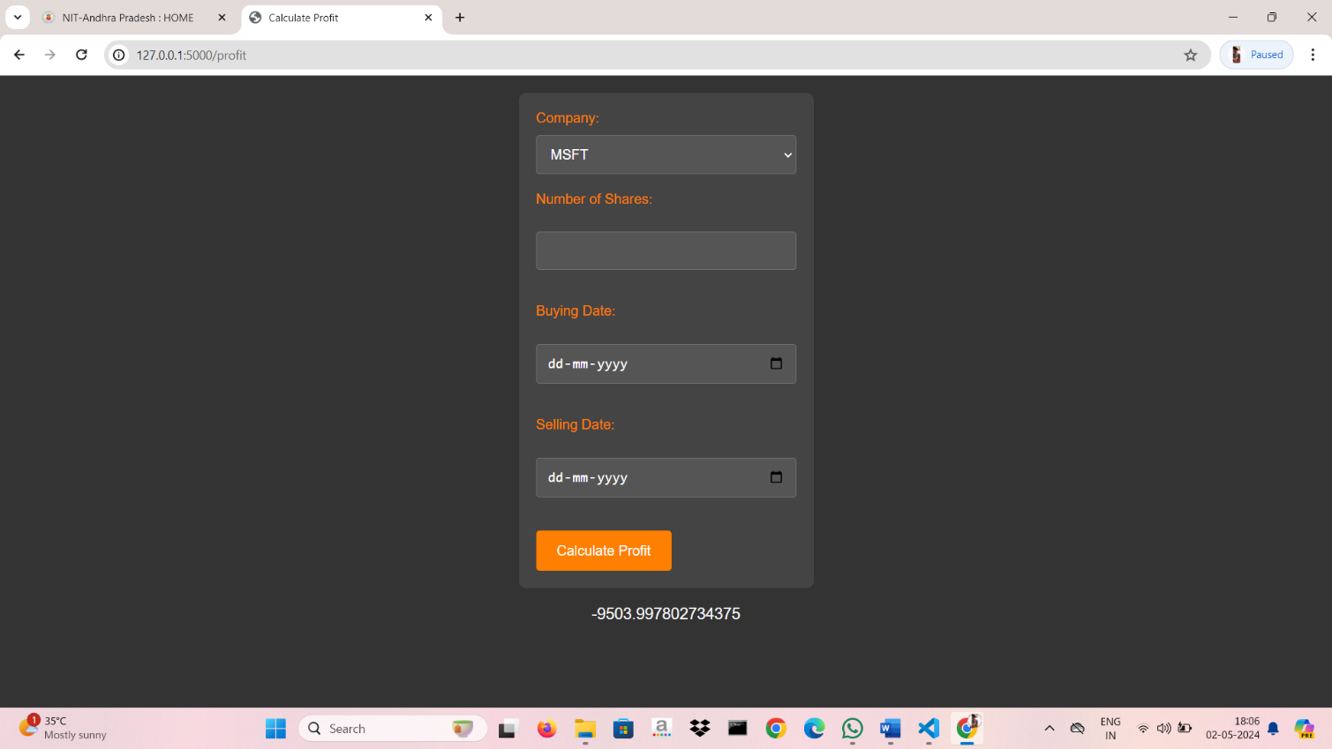
Results
Welcome page:
Home page:
Profit Calculator page:

Slide 21
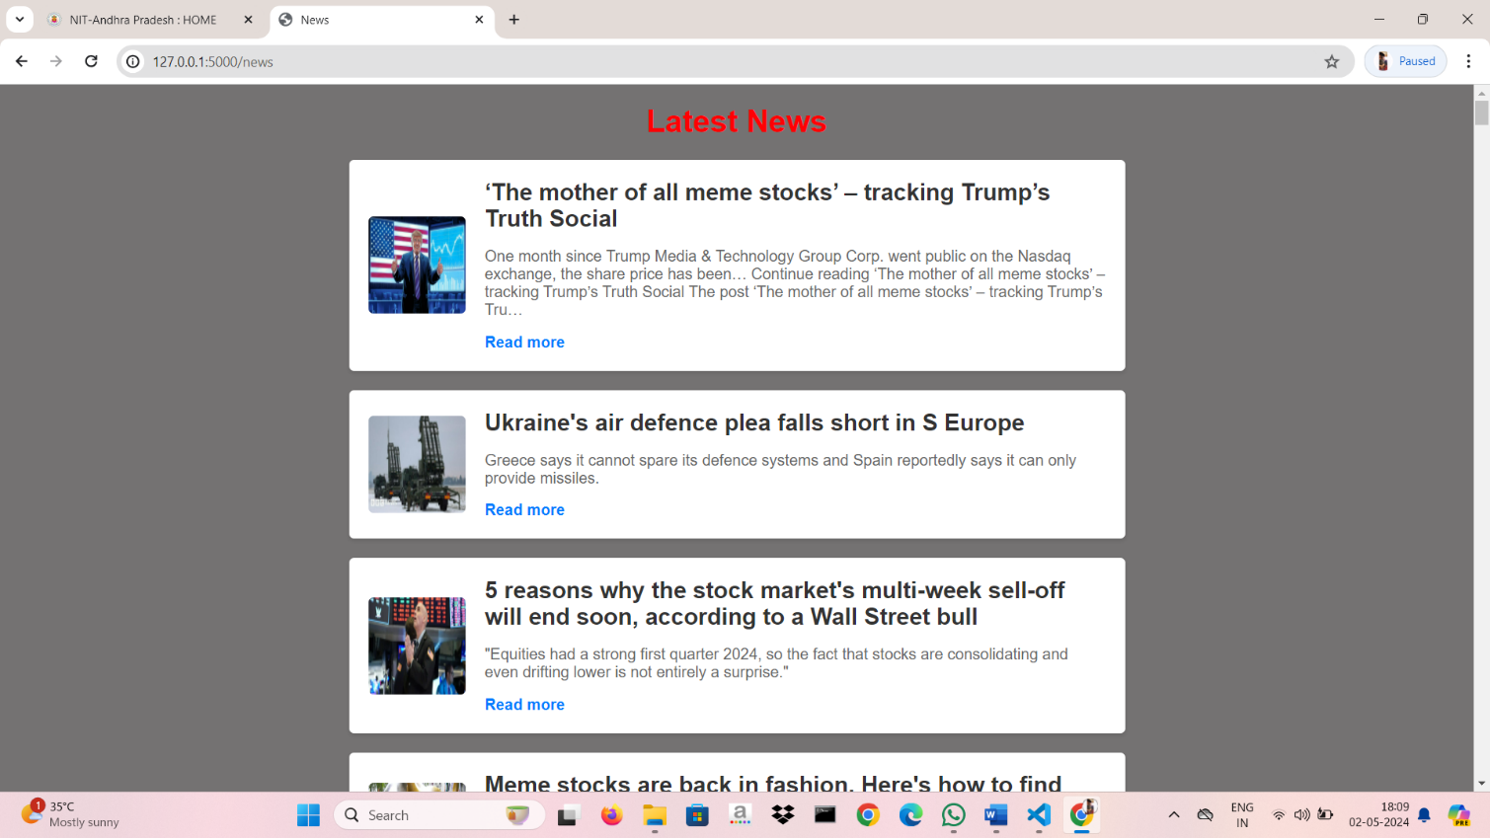
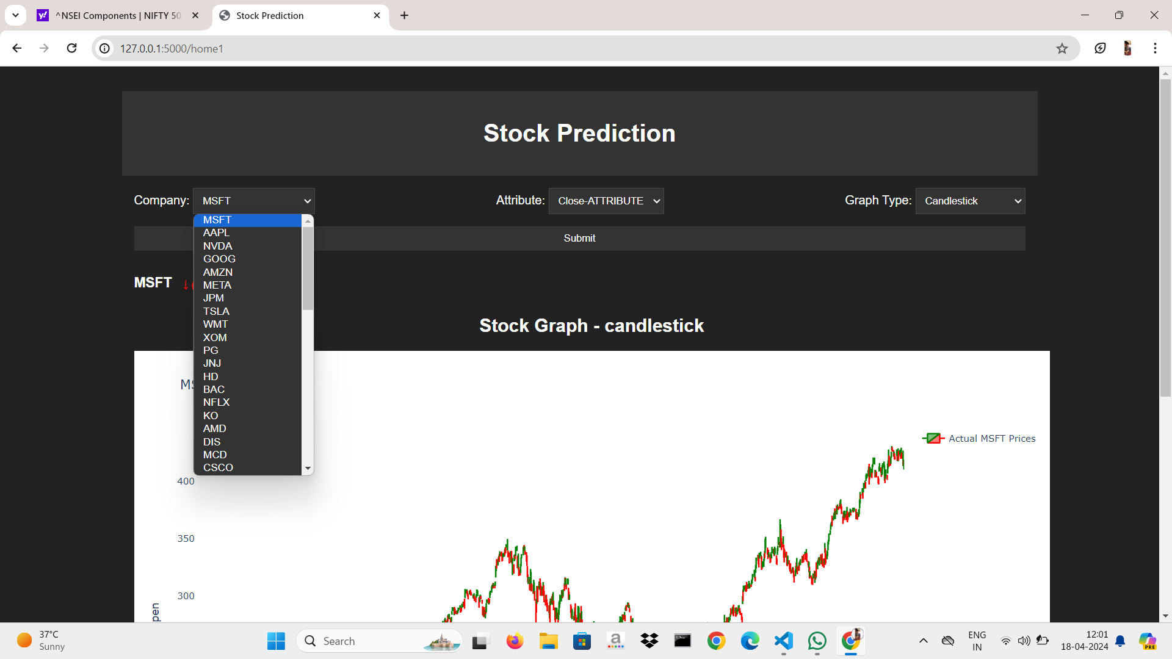
Results
News page:
Prediction page:

Slide 22
Results
Profit Calculator page:

Slide 23
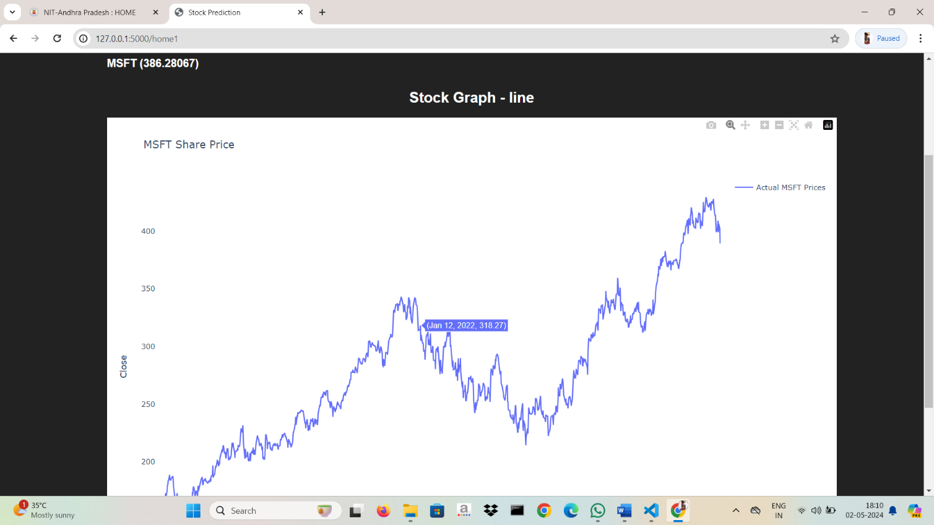
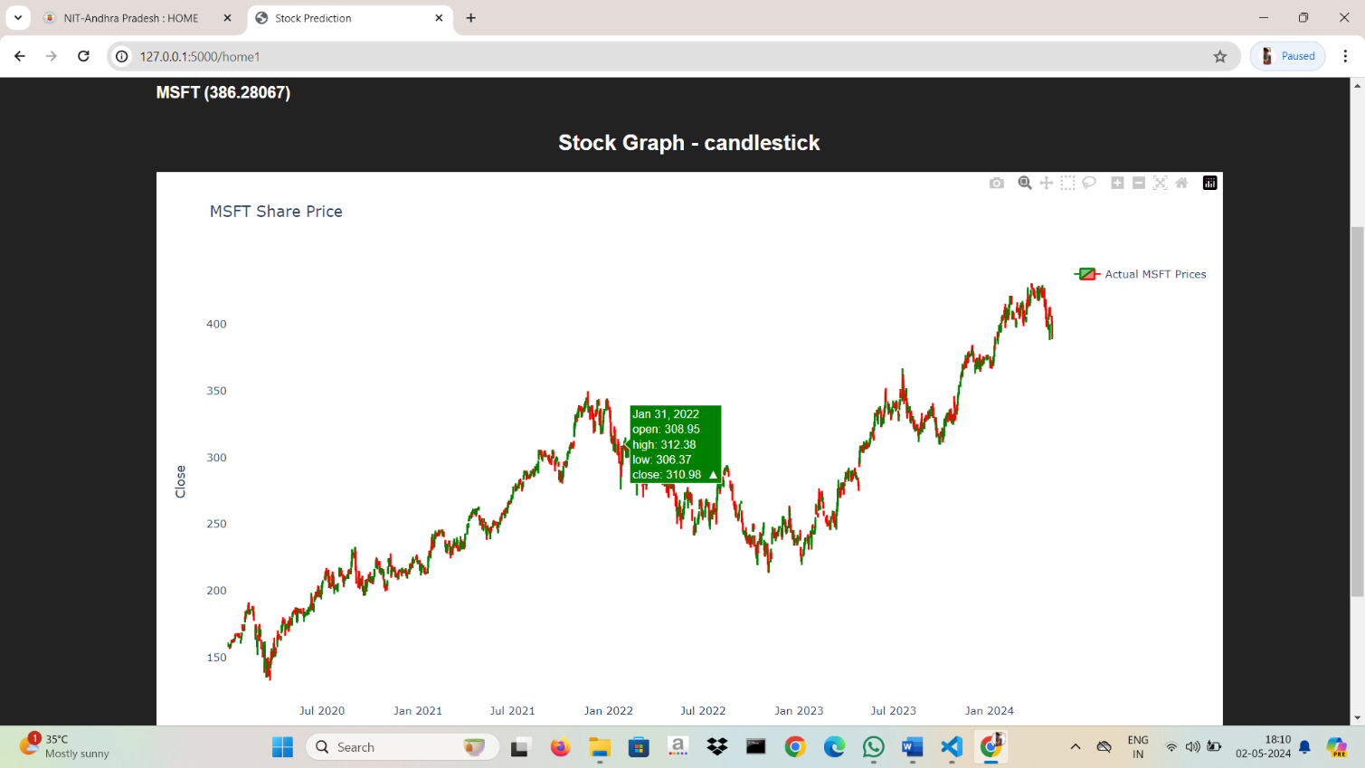
Results

Slide 24
Conclusion
Future work for this project could focus on several areas to enhance model accuracy and usability. Firstly, refining the LSTM architecture by experimenting with different configurations such as the number of layers, hidden units, and dropout rates could potentially improve predictive performance. Additionally, incorporating additional features such as technical indicators, sentiment analysis of news articles, or macroeconomic indicators could provide more comprehensive input data for the model, potentially leading to more accurate predictions. Moreover, implementing advanced techniques like attention mechanisms or hybrid models combining LSTM with other architectures could further enhance prediction capabilities. Furthermore, optimizing hyperparameters using techniques like grid search or Bayesian optimization could help fine-tune model performance. On the usability front, improving the web interface with features like real-time updating of predictions, customizable visualizations, and user-friendly tools for analysis could enhance the overall user experience.

Slide 25
References
Stock Market Prediction Using LSTM Recurrent Neural NetworkAuthor links open overlay panelAdil Moghar a, Mhamed Hamiche b
https://doi.org/10.1016/j.procs.2020.03.049
HTML Tutorial (w3schools.com) for html
https://www.w3schools.com/css for CSS
JavaScript Tutorial (w3schools.com) for java script

Slide 26
Thanks!

